Slide 1
Comparative Study Of Different Machine Learning Algorithms To Predict Heart Disease
By
Muhammad Raheem Zada
&
Shoaib Ahmad

Slide 2
Introduction
What is Machine Learning?
Goal of the Project
What is Supervised Learning?

Slide 3
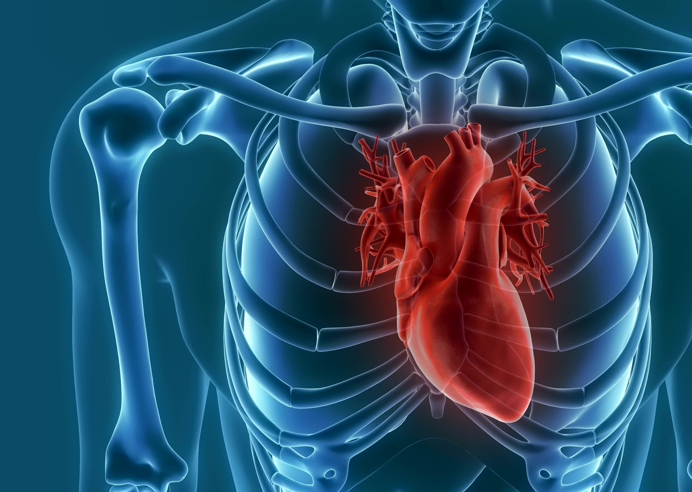
The Working of the Project

Slide 4
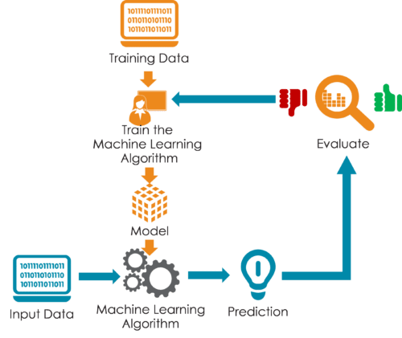
Workflow Diagram

Slide 5

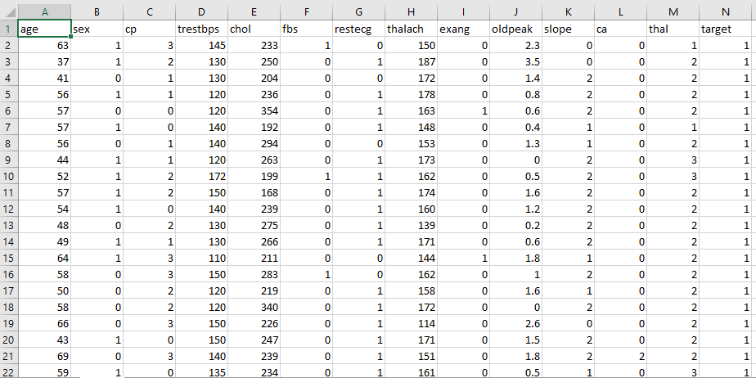
Dataset

Slide 7
3 Step Process
Split the dataset
Train the dataset
Compare the Algos

Slide 8





Used Libraries

Slide 9
Used Algorithms
Logistic Regression
Naïve Bayes
K-Nearest Neighbor
Decision Tree
Random Forest

Slide 11
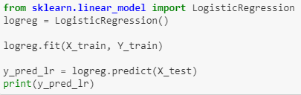
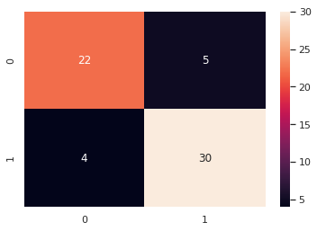
Logistic Regression
accuracy score : 85.25 %
Precision: 0.85
Recall is: 0.88
F-Score: 0.86

Slide 13
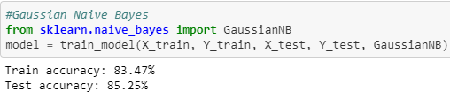
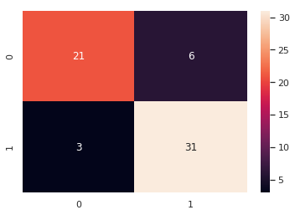
Naive Bayes
Precision: 0.83
Recall is: 0.91
F-Score: 0.87

Slide 15
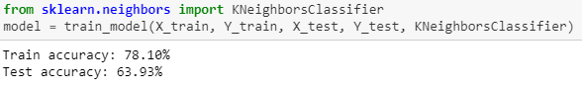
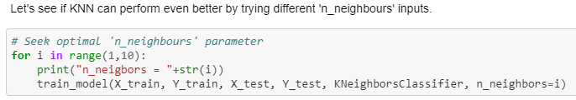
K-Nearest Neighbor

Slide 16
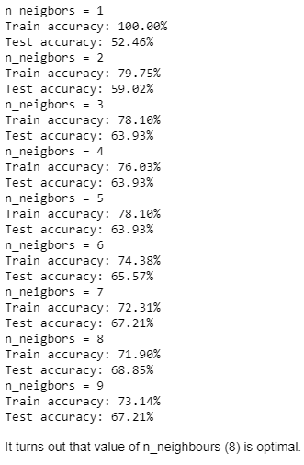
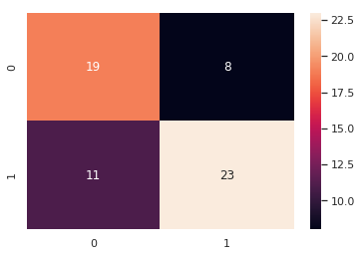
Precision: 0.74
Recall is: 0.67
F-Score: 0.70

Slide 18
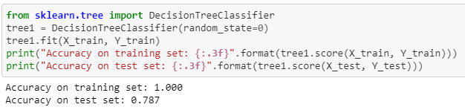
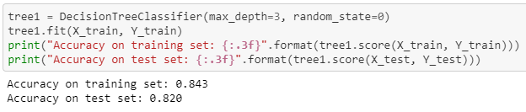
Decision Tree

Slide 19
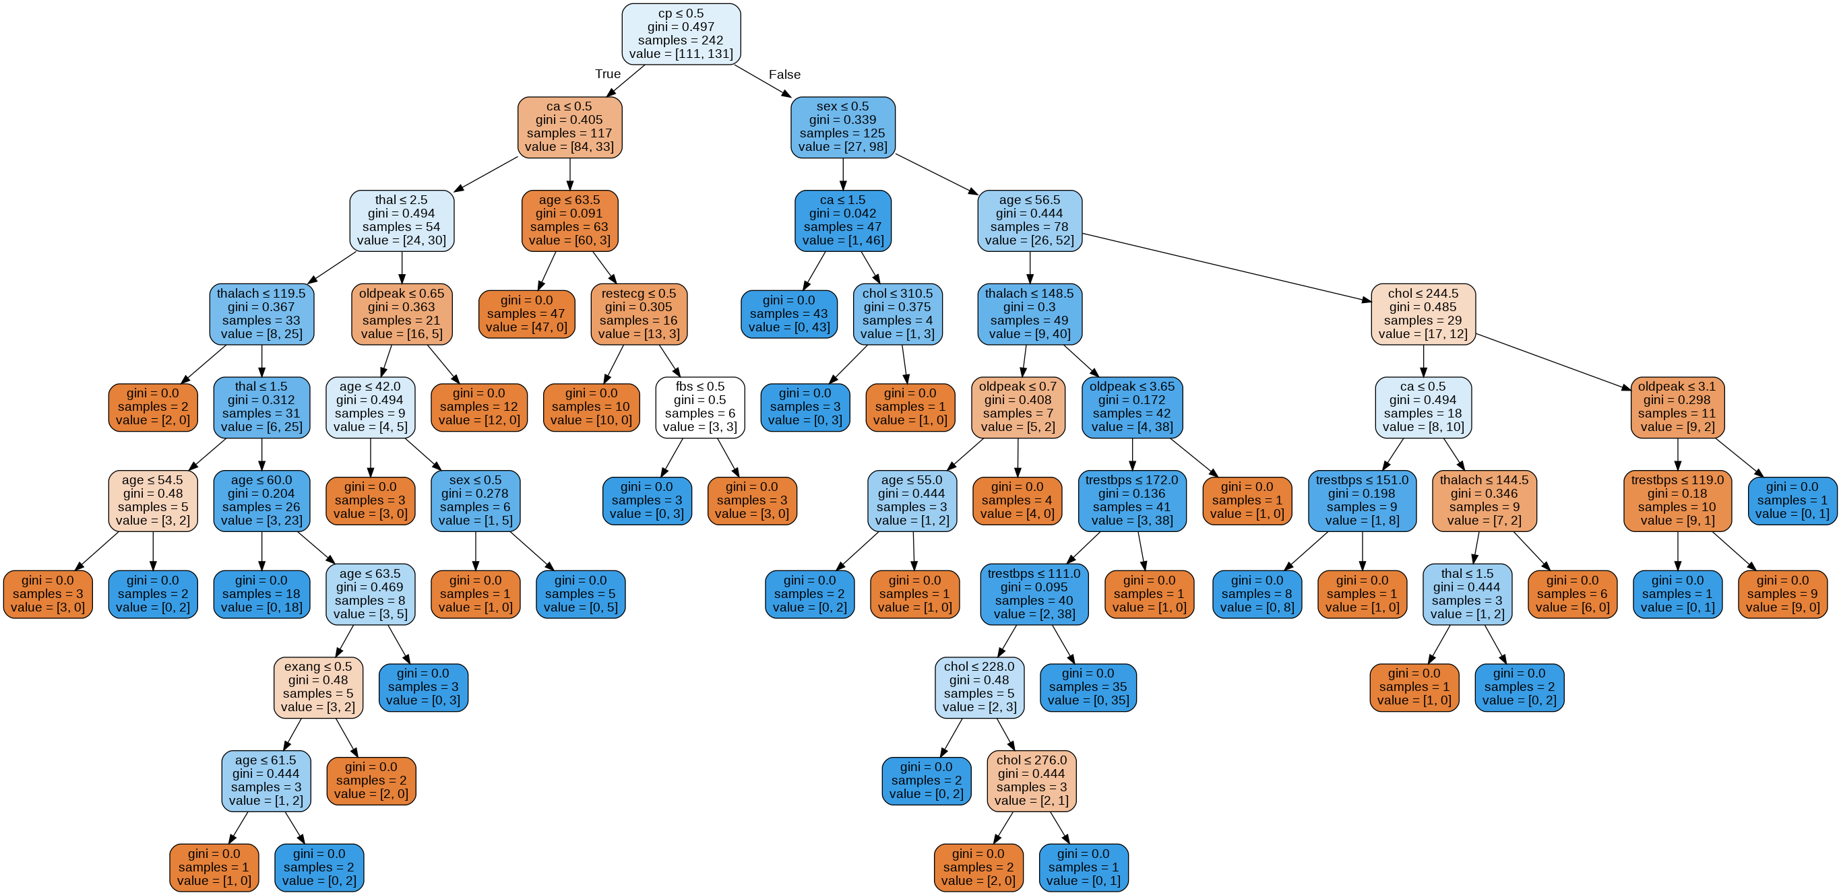

Slide 20
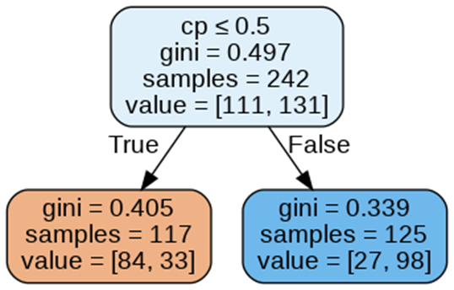

Slide 22
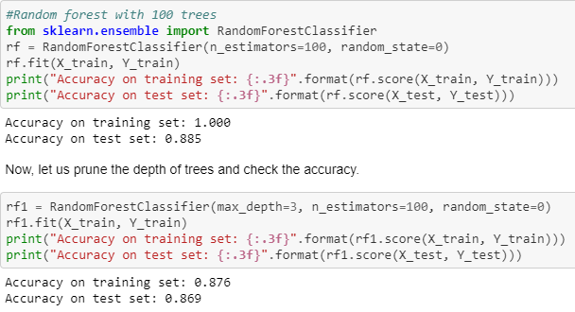

Random Forest
Precision: 0.86
Recall is: 0.91
F-Score: 0.88

Slide 23
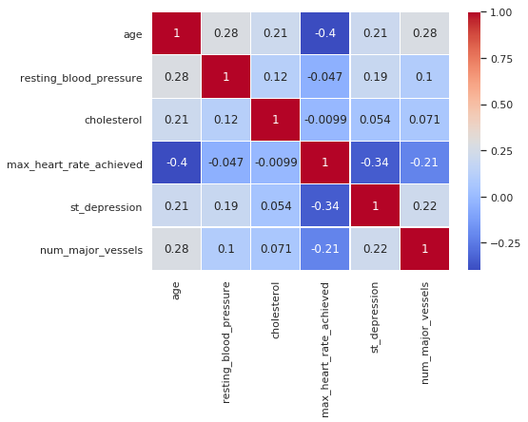
Correlation Plot

Slide 24
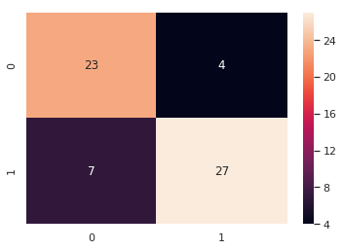
Confusion Matrix
Precision: 0.87
Recall is: 0.79
F-Score: 0.83

Slide 25
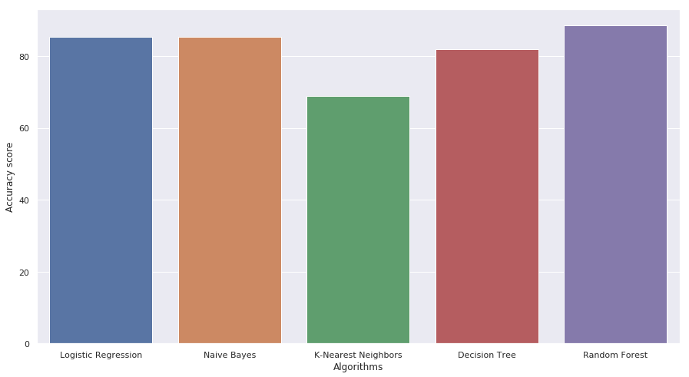
Results
85.24%
68%
81.9%
88.52%
85.24%

Slide 26
Results
Logistic Regression 85.24%
Naïve Bayes 85.24%
K-Nearest Neighbor 68%
Decision Tree 81.9%
Random Forest 88.52%

Slide 27
Conclusion

Slide 28
Drawbacks

Slide 29
Future Scopes

Slide 30
Thanks!
Any Question?
Reach us at:
raheemzad385@gmail.com
shoaibjan9233@gmail.com

